Slide 1
PDIOt PRESENTATION
Group G
Members: Jingkai Yuan, Shuo Chen, Hao Zhou

Slide 2
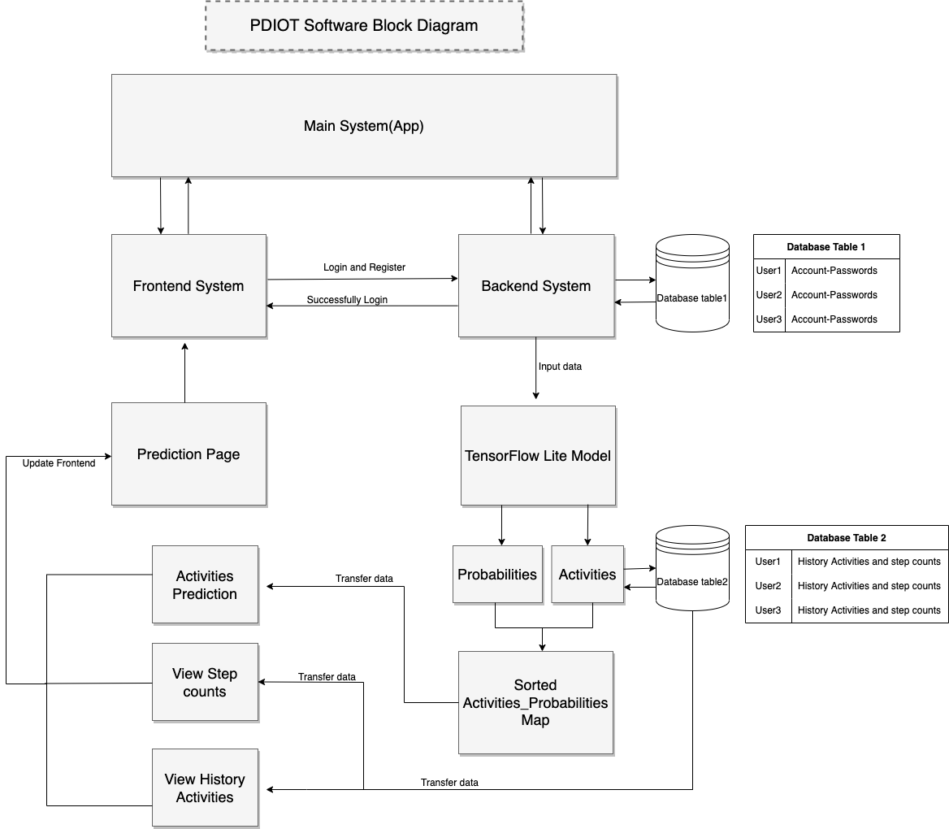
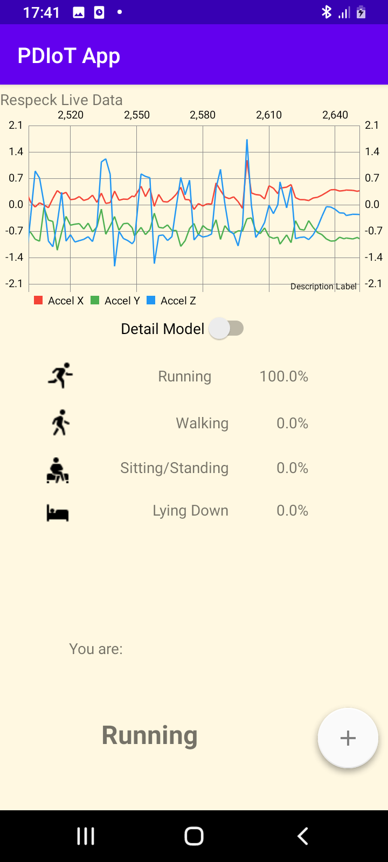
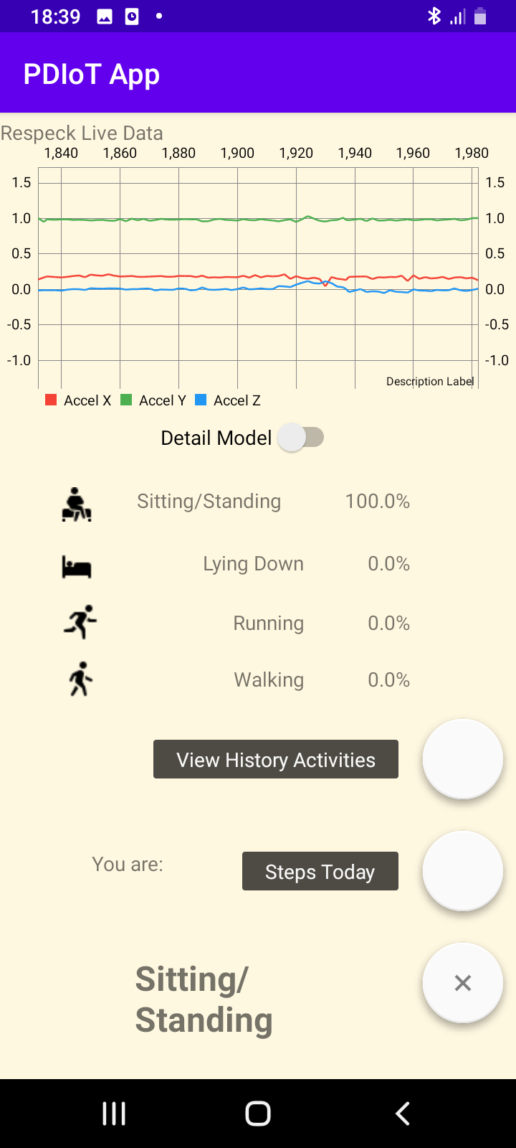

Slide 3
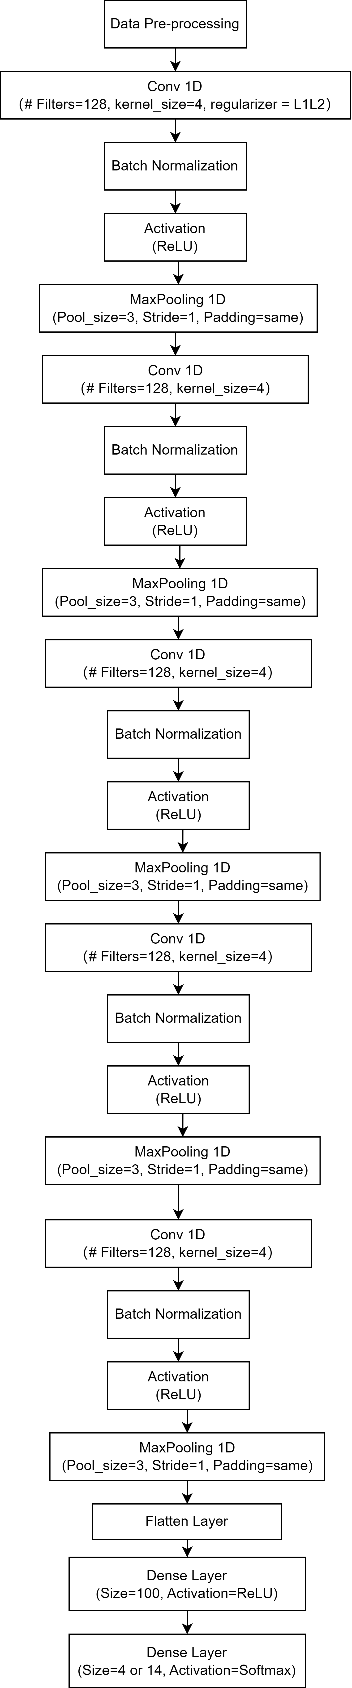
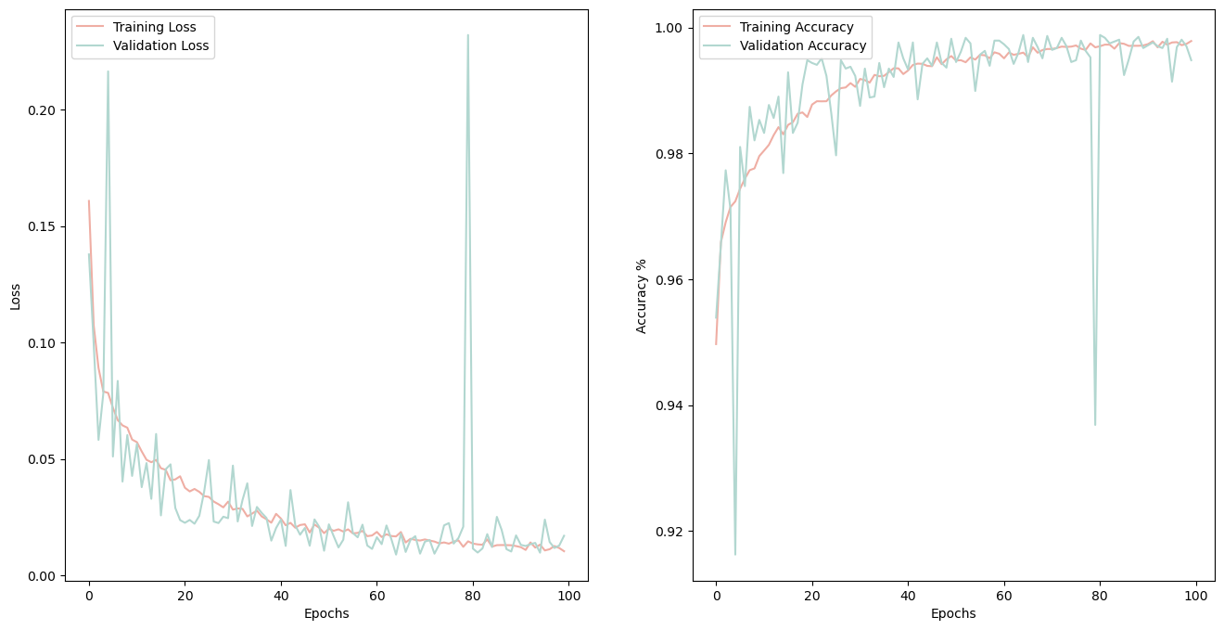
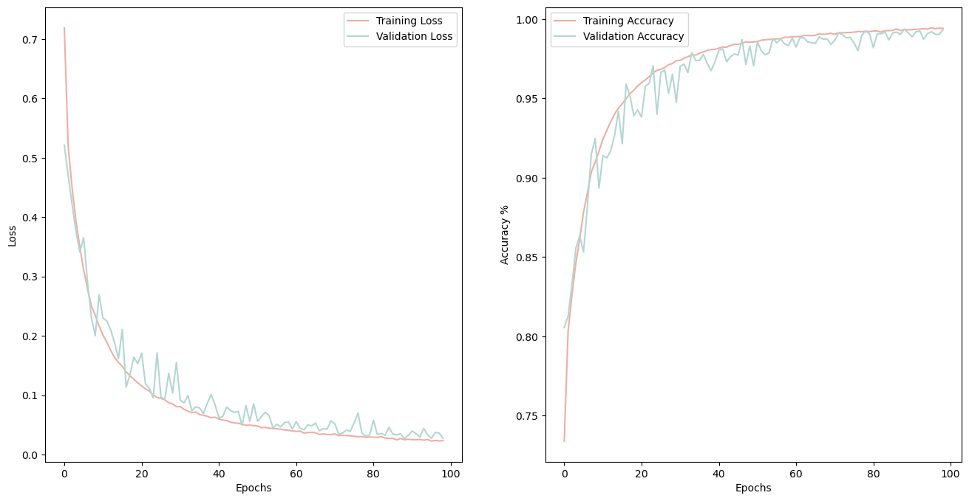
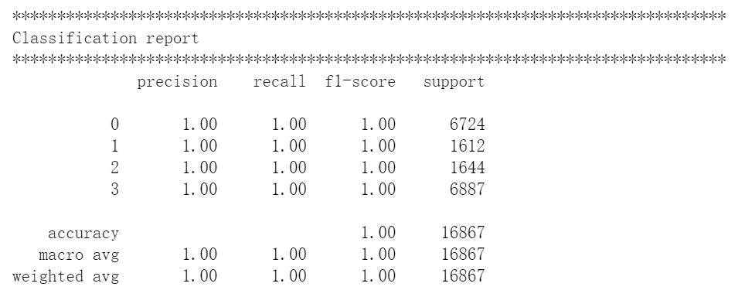
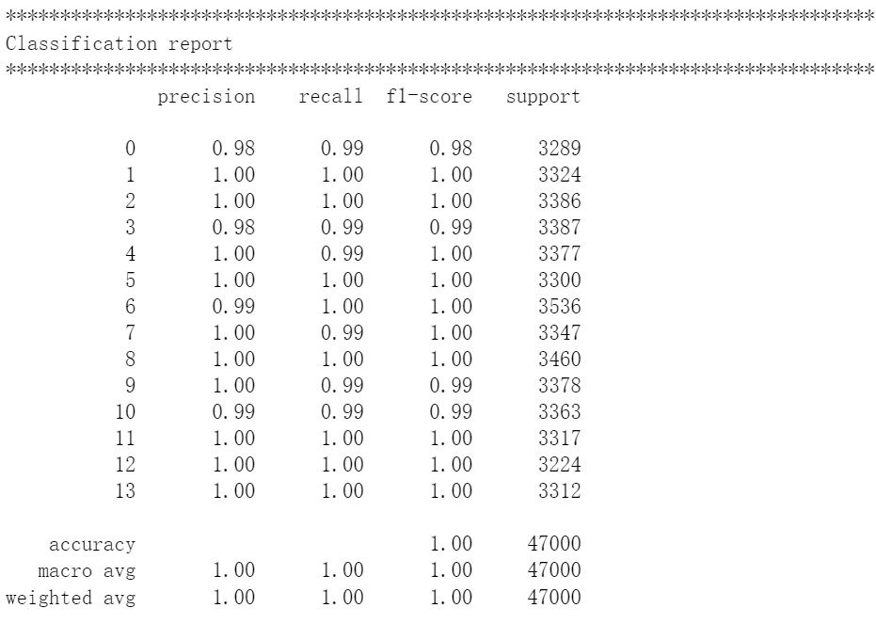
Four Types of Classification Result
Fourteen Types of Classification Result
Loss
Accuracy
Loss
Accuracy
- The 1D CNN model uses 128 kernels, kernel size 4, and ReLU activation function across all the layers.
- Each Conv 1D Layer is followed by a MaxPooling 1D Layer.
- Batch Normalization Layers are applied after each Conv 1D Layer

Slide 4

This video shows activities which cannot be easily demonstrated, such as climbing stairs, descending stairs, lying down, and so on.

Slide 5

This video shows step counting function.

